Slide 1
Session 5: Site-specific case studies

Slide 2
Burgess Farm, Salford
350 homes on a greenfield site was allowed by the SoS against the inspector's advice. Despite the permanent loss of an area of open countryside and the fact that the development would seriously degrade the character and appearance of the area. SoS considered that this was outweighed by the scheme's contribution to reducing the significant shortfall of some 4,000 homes (2.5 years supply) against the five year housing land requirement.
DCS Number 100-078-099

Slide 3
Barnet & Chase Farm: APP/Q5300/A/07/2043798/NWF
The Inspector stated that:
‘the appropriate test is that the value generated by the scheme should exceed the value of the site in its current use. The logic is that, if the converse were the case, then sites would not come forward for development’.

Slide 4
Clay Farm, Cambridge - 07/0621/OUT
Residential development of up to 2,300 new mixed-tenure dwellings and accompanying provision of community facilities; sports and recreation facilities and landscaped open spaces including 49 ha. of public open space in the green corridor
Provision for education facilities; and all related infrastructure including: all roads and associated infrastructure, alternative locations for Cambridgeshire guided bus stops, alternative location for CGB Landscape Ecological Mitigation Area, attenuation ponds including alternative location for Addenbrookes's Access Road pond, cycleways, footways and crossings of Hobson's Brook.

Slide 5
Clay Farm, Cambridge - 07/0621/OUT
The SoS agrees with the Inspector that the appellants’ approach to assessing viability has the effect of protecting historic land values as well as insulating the developer against a risk for which he is already indemnified by profit margins and that this would be at the expense of affordable housing levels. He therefore also agrees with the Inspector that the residual land value (RLV) approach used by the Council is the appropriate methodology for evaluating the economics of these developments…he is concerned that there is nowhere else to accommodate the affordable housing at the levels intended for these sites in the development plan. The SoS attaches very substantial weight to this matter and considers that it outweighs the shortfall in the Council's five year supply of developable sites.

Slide 6
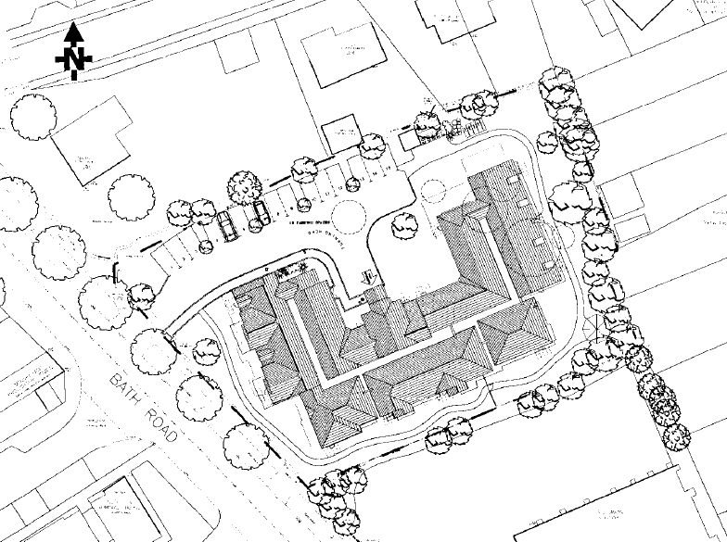
Bath Road, Bristol: APP/P0119/A/08/2069226

Slide 7
Bath Road, Bristol: APP/P0119/A/08/2069226
McCarthy & Stone – 29 sheltered apartments for the elderly including associated communal facilities and car parking.
A main issue at appeal was whether the proposal would make suitable provision for affordable housing. Policy seeks 33.3% affordable housing. On-site not suitable therefore parties agreed that an off-site contribution was acceptable subject to viability.
At the Inquiry appellant stated viability of the proposal would only allow a contribution of £115,000 which would fund only 1 or 2 affordable units, and is well below the target of 33.3%. The LPA were seeking circa £414k based on previous successful appeal decisions.

Slide 8
Bath Road, Bristol: APP/P0119/A/08/2069226
Both parties conducted appraisals using the old Housing Corporation model. There were differences between the parties on BCIS construction costs, finance costs, contingency, developers profit, build rates and CfSH. Resulting in different residual values from LPA and appellant.
LPA argued that the appellant had inflated costs of the scheme. LPA used a comparable site from another appeal. Inspector placed little weight on this approach as that comparable scheme had not yet come forward. Further he felt the appellants assumptions were reasonable and evidenced.

Slide 9
Bath Road, Bristol: APP/P0119/A/08/2069226
‘the difference between the Residual Land Value (RLV) and the existing site value provides a basis for ascertaining the viability of contributing towards affordable housing’.
“Any reservations that I may have about the balance of viability arguments are outweighed by what I consider are clear benefits of the proposal.” (due to lack of sheltered housing locally).

Slide 10
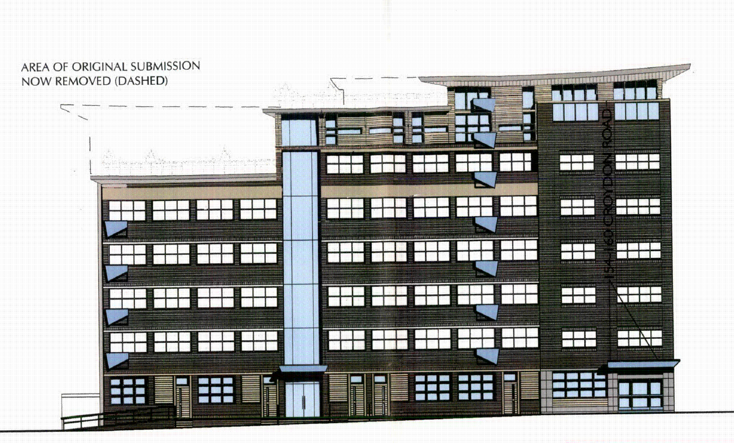
Beckenham: APP/G5180/A/08/2084559

Slide 11
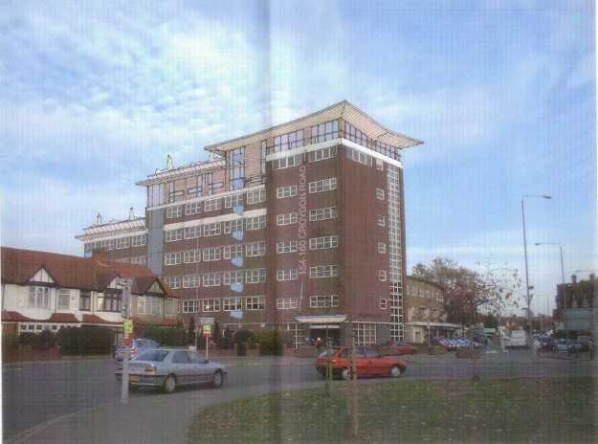
Beckenham: APP/G5180/A/08/2084559

Slide 12
Beckenham: APP/G5180/A/08/2084559
Change of use of office to residential and enlargement to comprise 55 dwellings including key worker and affordable housing. Elevational alterations and part seventh/eighth floor extensions, screened roof terrace
Main issues – whether the proposed development meets development plan policies concerning the provision of affordable housing or a payment in lieu thereof and, whether there are any other material planning considerations relevant to the determination of the case.

Slide 13
Beckenham: APP/G5180/A/08/2084559
At the Inquiry a SoCG was submitted agreeing the residual site value with no affordable housing (£2.773 million), the residual value with affordable housing (£1.9223 million) and the existing use value of the site (£2.482 million). These agreed values determine that without an affordable housing contribution, the scheme will only yield less than 12% above the existing use value, 8% below the generally accepted margin necessary to induce such development to proceed. Self-evidently, with a 35% AH target, such a scheme must also be, in the view of the appellant, considered non-viable.

Slide 14
Beckenham: APP/G5180/A/08/2084559
…when the agreed residual value of the site, incorporating 35% affordable housing is set against CUV, the development becomes unviable. Having carefully weighed the matter, I conclude the viability report convincingly demonstrates that the proposals cannot support any affordable housing; accordingly they are not in contravention of LBB and LP affordable housing policy.

Slide 15
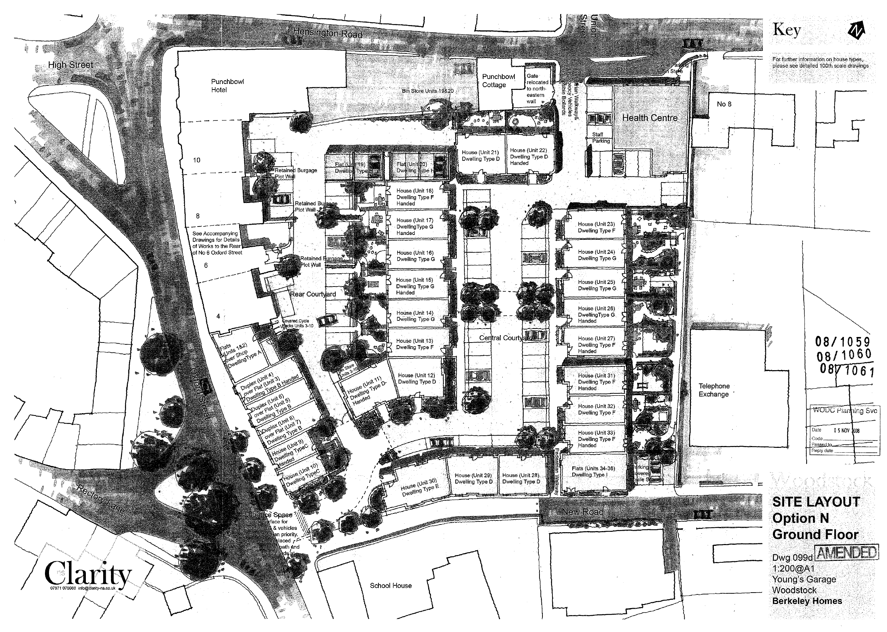
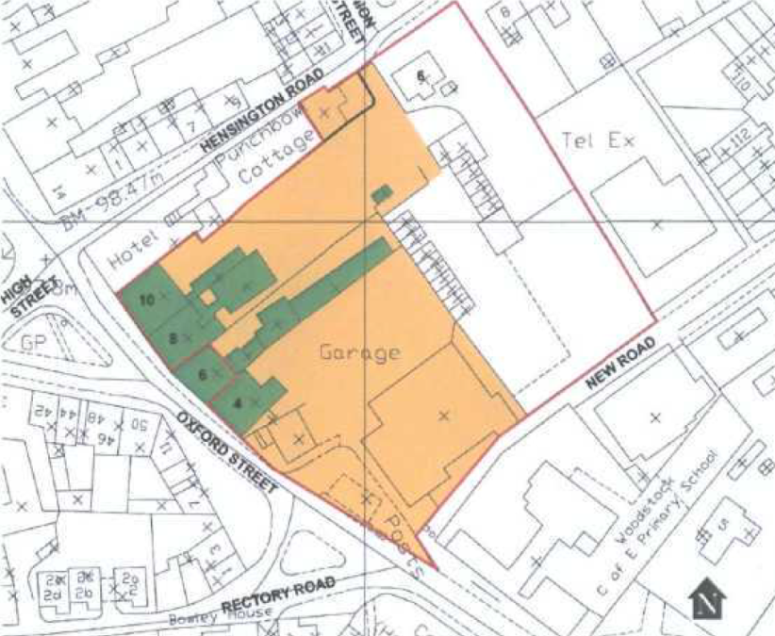
Oxford Street, Woodstock: APP/D3125/A/09/2104658

Slide 16
Oxford Street, Woodstock: APP/D3125/A/09/2104658
Multiple appeals due to alterations
Demolition of Youngs Garage and 6 Hensington Road, erection of 36 dwellings, health centre and retail unit. Associated parking, roads and footpaths. Alterations to 6,8 and 10 Oxford Street and minor alterations to Punch Bowl Cottage.
Appeals made under section 78 of the Town and Country Planning Act 1990 against a refusal to grant planning permission and under section 20 and 74 of the Planning (Listed Buildings and Conservation Areas) Act 1990 against a refusal to grant listed building consent.

Slide 17
Oxford Street, Woodstock: APP/D3125/A/09/2104658
This case focuses on the margin required over and above the Existing Use Value in order to achieve a change of use of the land:
‘The main parties valuations of the current existing value of the land are not dissimilar but the Appellant has sought to add a 10% premium. Though the site is owned by the Appellants it must be assumed, for valuation purposes, that the land is being acquired now. It is unreasonable to assume that an existing owner and user of the land would not require a premium over the actual value of the land to offset inconvenience and assist with relocation. The Appellants addition of the 10% premium is not unreasonable in these circumstances.’

Slide 18
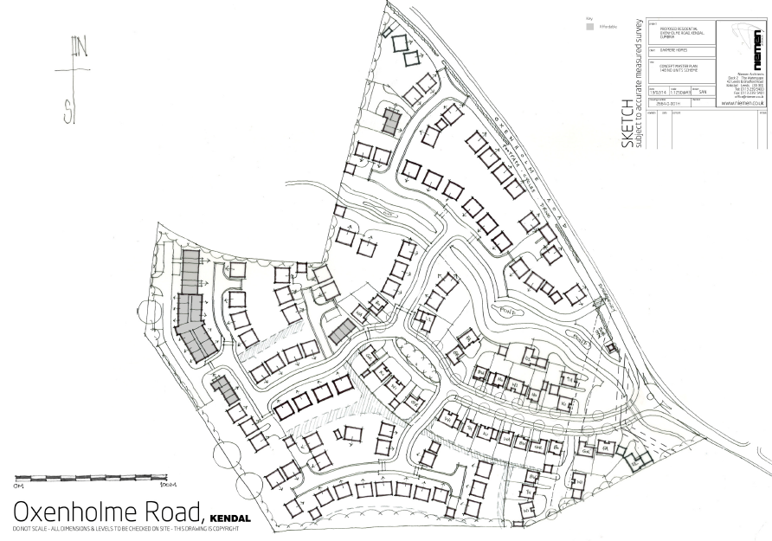
Oxenholme Road, Kendal, Cumbria APP/M0933/A/13/2193338

Slide 19
Oxenholme Road
Background and main issues
Appeal for outline planning permission for the construction of 148 no. dwellings at land to the west of Oxenholme Road, Kendal, Cumbria (6.95 hectares at the edge of the built-up area of Kendal)
Main issue is if there is less than a five year supply of developable housing land
Also the provision of affordable housing; the effect on highway and transport infrastructure; the suitability of the site for residential development, in particular the effect on the Green Gap between Kendal and Oxenholme.

Slide 20
Oxenholme Road
16. …requirement for 35% affordable housing
18. …appellants dispute the viability implications
21. The concept of a ‘competitive return’ is not further defined by the NPPF, and could be the subject of differing interpretations by the parties involved in any particular development. The assessment of a competitive return will involve an element of judgement. Clearly, however, excessively ambitious predictions must be tempered by comparison with industry norms and local circumstances.

Slide 21
Oxenholme Road
22. …it is common ground that a competitive return for the developer can be taken as a profit of 18-20% of GDV
23. …The issue therefore becomes the achievement of a competitive return for the land owner.
24. …the Council proposes the margin settled upon by the consultants who prepared the recent Viability Study in support of the Local Plan. At an EUV of £50,000/hectare, to reflect higher value ‘paddock’ use at the urban fringe rather than basic agricultural value, with a margin of 20% plus £400,000/hectare the site value would amount to £3,197,000 [£246,873/net developable acre]

Slide 22
Oxenholme Road
25. However, the RICS guidance note on viability points out concerns about the potential inaccuracy of the EUV plus margin method, and does not recommend it. The Harman report on viability testing of plans also points out the weakness of this approach when dealing with agricultural land at the urban edge. In the present case, the figures adapted from the LADPD Viability Study are broad brush, and the precise rationale for the £400,000 margin is not open to interrogation.

Slide 23
Oxenholme Road
25. …Furthermore, I note that representations made for the Local Plan on behalf of the Cumbria House Builder Group in response to the Viability Study are firmly of the view that the level proposed would not encourage landowners to bring forward sites for development. The figure of £246,873 would be well below the £500,000/net developable acre proposed by the House Builder Group and favoured by the appellants in this appeal.

Slide 24
Oxenholme Road
26. Therefore, although I note that the EUV plus margin method has been accepted in other situations, such as the examination of the London CIL charging schedule, and may be useful at an area-wide level, in this case I consider that greater weight must be given to the residual method of determining the site value, which has also been followed by the appellants.

Slide 25
Oxenholme Road
27. … The appellants’ single appraisal seeks to demonstrate that, at their preferred lower sales values and the same benchmark land value, the scheme without any affordable housing would result in a surplus of £335,000the appellants’ conclusion is that this amount would allow 10% affordable housing provision, subject to some ‘flex’ by the parties on their level of return and on the tenure of the housing.

Slide 26
Oxenholme Road
The Council and appellant differed on build costs and sale prices
Inspector accepted evidence from QS that costs were reasonable
The Council claimed the lower market values taken from their LADPD viability study were cautious ‘worst case’ approach. However, without enough available comparables the Inspector sides with the appellant stating the Council’s values would be uncompetitive, harm cash flow and could affect buyers’ ability to access borrowing i.e. he used a reality check!

Slide 27
Oxenholme Road
On land value the Council defended it’s £4000,000/net developable acres (backed by the LADPD viability study) vs. the appellants £500,000/net developable acre (backed by the Cumbria House Builder Group)
Various comparables were used in favour of each benchmark land value level.

Slide 28
Oxenholme Road
47. The parties refer to an appeal decision for land at Shinfield, Berkshire, which is quoted in the LADPD Viability Study. However, little weight can be given to that decision in the present case, as the nature of the site was quite different, being partly previously developed, and the positions taken by the parties on the proportion of uplift in site value that should be directed to the provision of affordable housing were at odds with those now proposed. There is no reason in the present case to assume that either 100% or 50% of the uplift in site value is the correct proportion to fund community benefits.

Slide 29
Oxenholme Road
51. …I am unable to conclude that a higher benchmark value than £400,000/net developable acre should be accepted in this appeal. The evidence for the higher figure proposed by the appellants is not conclusive, being based largely on one small comparator site of a different quality and on a relatively broad brush method of checking land value against GDV. Although contested, the LADPD Viability Study suggests that not all owners have expectations in excess of the £400,000 level ...the expectations of one land owner are not critical in the determination of a benchmark level, which relates to the reasonable expectation of a typical owner.

Slide 30
Oxenholme Road
52. …I consider that there are grounds to conclude that a lower benchmark figure would be reasonable. I conclude that the need to set a benchmark land value of £500,000/net developable acre, on which the appellants’ case is based, has not been conclusively demonstrated.
53. The appellants’ viability appraisal shows that with no affordable housing, the scheme could generate a surplus of £335,000 at the higher benchmark land value, which the appellants state could support an affordable housing provision of 10%. It is clear that a lower land value would generate a larger surplus, which would thus support a higher proportion of affordable housing…which would equate to more than £400,000/net developable acre.

Slide 31
Oxenholme Road
57. …in the absence of clear evidence that the proposal could not generate a competitive return for both developer and landowner at the policy approved level of provision, I conclude that a condition requiring 35% affordable housing would be reasonable and necessary and would comply with the guidance of the NPPF and meet the tests of Circular 11/95
95. The acute need for affordable housing is accepted. It has not been shown that the development requires a proportion of affordable housing below the policy minimum of 35% in order to generate a competitive return.

Slide 32
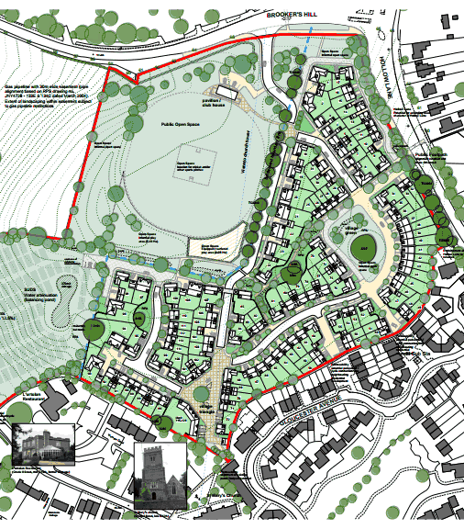
Shinfield
APP/X0360/A/12/2179141
Reading University
Wokingham Council
8th January 2013

Slide 33
Site and scheme
8.5 ha, 5 km south of Reading
Was National Institute for Research into Dairying (closed in 1980s)
4.5 ha within development limits – with buildings etc
4 ha beyond development limits – pasture
To clear site and build 126 new dwellings within development limits – remainder to be open space etc

Slide 34
History
Long history
18,766m2 of B1 in 1992
2001 identified as being suitable for 80 dwellings by Local Plan inspector
2003 part of site developed
The principle of development was not contested.

Slide 35
Main Issues
‘The main issues are: (i) whether the proposals make adequate provision for mitigating any adverse impact they would have upon local services and infrastructure; and (ii) whether the proposed amount of affordable housing would be appropriate in the context of the viability of the development, the National Planning Policy Framework, development plan policy and all other material planning considerations.’

Slide 36
The problem
The Council wanted…
The Developer offered…
£2,028,920 in developer contributions
40% affordable housing (policy says subject to viability)
Higher sales prices
Lower developers profit
Different Benchmark land value / site value
£2,312,569 in developer contributions
2% affordable housing

Slide 37
Developers Profit
The appellants supported their calculations by providing letters and emails from six national housebuilders who set out their net profit margin targets for residential developments. The figures ranged from a minimum of 17% to 28%, with the usual target being in the range 20-25%. Those that differentiated between market and affordable housing in their correspondence did not set different profit margins. Due to the level and nature of the supporting evidence, I give great weight it. I conclude that the national housebuilders’ figures are to be preferred and that a figure of 20% of GDV, which is at the lower end of the range, is reasonable.

Slide 38
Benchmark land value
There is a significant difference in the figures produced by the parties. The Council calculated a Benchmark Land Value of £1,984,000 (reduced to about £1,865,000 when decontamination costs were agreed); the appellants calculate it to be £2,325,000. During the Inquiry reference was made to Current Use Value (CUV) and Existing Use Value (EUV) but it was agreed that these definitions are interchangeable in respect of the calculations used for this site.

Slide 39
The Appellant’s approach
The appellants’ valuation of the site is £2,325,000 based upon 8 acres of commercial open storage/ industrial land and buildings at £250,000 per acre and 13 acres of settlement fringe at £25,000 per acre. The figure of £250,000 per acre seems reasonable in the light of the recent sale value achieved at the smaller site at Paddock Road (£330,000 per acre).

Slide 40
The Council’s approach
The Council did not use comparators; instead it relied upon a valuation based upon a substantial office scheme on the appeal site. This was based upon the outline planning permission for offices on the site in 2003 that was renewed in 2006 but which has since lapsed...I am concerned about this approach in that the Council has failed to demonstrate that there is any market for such a substantial office development here. Indeed, the only recently completed (2009) office development of comparable scale, The Blade in Reading, is still largely vacant.

Slide 41
Competitive Return
Determining what constitutes a competitive return inevitably involves making a subjective judgement based upon the evidence. Two very different viewpoints were put forward at the Inquiry with the appellants seeking a land value of £4,750,000 which is roughly the mid-point between the EUV/CUV and the RLV with planning permission for housing and no obligations. This ties in with the 50:50 split between the community and the landowner sought by the appellants. The Council considered that a sum of £1.865m would ensure a competitive return; that is to say the Council’s calculation of the EUV/CUV.

Slide 42
Competitive Return
Paragraph 173 of the Framework says that the costs of any requirements should provide competitive returns to a willing landowner and willing developer to enable the development to be deliverable. The paragraph heading is “Ensuring viability and deliverability”; it is clear that its objective is to ensure that land comes forward for development.

Slide 43
Competitive Return
I am not convinced that a land value that equates to the EUV/CUV would provide any incentive to the landowner to sell the site...such a conclusion would not provide any incentive to the landowner to carry out any remediation work. There would be no incentive to sell the land and so such a low return would fail to achieve the delivery of this site for housing development. In these circumstances, and given the fact that in this case only two very different viewpoints on what constitutes a competitive return have been put forward, the appellants’ conclusions are to be preferred. In the scenario preferred by the Council, I do not consider that the appellants would be a willing vendor.

Slide 44
Viable amount of affordable
The RICS GN says that any planning obligations imposed on a development will need to be paid out of the uplift in the value of the land but it cannot use up the whole of the difference, other than in exceptional circumstances, as that would remove the likelihood of land being released for development. That is exactly what is at issue here in that the Council’s valuation witness, in cross examination, stated that a landowner should be content to receive what the land is worth, that is to say the SV. In his opinion this stands at £1.865m. I accept that, if this figure was agreed (and it is not), it would mean that the development would be viable.

Slide 45
Viable amount of affordable
However, it would not result in the land being released for development. Not only is this SV well below that calculated by the appellants, there is no incentive to sell. In short, the appellants would not be willing landowners. If a site is not willingly delivered, development will not take place. The appellants, rightly in my opinion, say that this would not represent a competitive return. They argue that the uplift in value should be split 50:50 between the landowner and the Council. This would, in this instance, represent the identified s106 requirements being paid as well as a contribution of 2% of the dwellings as affordable housing.

Slide 46
And finally
I conclude on this issue that, allowing the landowner a competitive return of 50% of the uplift in value, the calculations in the development appraisal allowing for 2% affordable housing are reasonable and demonstrate that at this level of affordable housing the development would be viable (Document 26). The only alterations to these calculations are the relatively minor…

Slide 47
Case study: South Lakeland

Slide 48
Shinfield Test
We do not accept that Shinfield is an authoritative precedent for Plan wide viability testing
Under the Shinfield principles the uplift from granting planning consent is shared 50:50 between the landowner and the local authority.

Slide 49
£1,000,000 viability Threshold
Table 10.3 Residual Value compared to £1,000,000/ha Viability Threshold (£/net ha)
 |  |  | Alternative Land Value | Viability Threshold | Affordable %
 |  |  |  |  | 0% | 25% | 30% | 35% | 40%
Site 1 | Urban Edge 1 | Kendal | 25,000 | 1,000,000 | 1,443,027 | 1,148,255 | 1,083,908 | 1,017,109 | 948,778
Site 2 | Urban Edge 2 | Kendal | 25,000 | 1,000,000 | 1,455,240 | 1,130,680 | 1,059,830 | 986,281 | 911,045
Site 3 | Office re-development | Kendal | 400,000 | 1,000,000 | 732,148 | 412,529 | 346,134 | 272,991 | 198,171
Site 4 | Estate Infill | Kendal | 50,000 | 1,000,000 | 1,716,295 | 1,404,668 | 1,333,530 | 1,258,469 | 1,182,385
Site 5 | LSC Infill | Arnside | 50,000 | 1,000,000 | 1,089,497 | 860,561 | 808,331 | 754,112 | 698,649
Site 6 | LSC Infill | Grange | 50,000 | 1,000,000 | 1,315,092 | 1,015,954 | 950,654 | 882,866 | 813,524
Site 7 | Cleared Urban | Ulverston | 300,000 | 1,000,000 | 399,698 | 153,528 | 100,147 | 43,821 | -13,273
Site 8 | KSC Urban Edge | Milnthorpe | 25,000 | 1,000,000 | 1,319,627 | 1,034,413 | 971,956 | 908,733 | 841,158
Site 9 | LSC Edge | Allithwaite | 50,000 | 1,000,000 | 1,879,318 | 1,474,114 | 1,385,383 | 1,307,848 | 1,210,926
Site 10 | LSC Edge | Endmoor | 50,000 | 1,000,000 | 1,266,331 | 1,000,000 | 949,065 | 889,158 | 825,151
Site 11 | LSC Paddock | Penny Bridge | 50,000 | 1,000,000 | 1,648,636 | 1,320,890 | 1,245,698 | 1,169,586 | 1,088,227
Site 12 | Small Village | Lune Valley | 50,000 | 1,000,000 | 1,952,203 | 1,952,203 | 1,952,203 | 1,952,203 | 1,952,203
Site 13 | Ex Garage Site | Central SLDC | 400,000 | 1,000,000 | 457,674 | 212,560 | 159,053 | 103,507 | 46,688
Site 14 | Village Infill | Cartmel Peninsula | 50,000 | 1,000,000 | 1,522,498 | 1,203,186 | 1,130,073 | 1,056,066 | 976,954
Site 15 | Village Infill | Eastern Area | 50,000 | 1,000,000 | 552,018 | 552,018 | 552,018 | 552,018 | 552,018
Site 16 | Rural House | Rural west | 50,000 | 1,000,000 | 75,454 | 75,454 | 75,454 | 75,454 | 75,454
 | Castle Green Road | Kendal | 25,000 | 1,000,000 | 1,098,652 | 858,474 | 806,045 | 751,618 | 695,942
 | Quarry Lane | Storth | 25,000 | 1,000,000 | 1,175,868 | 866,671 | 799,175 | 729,108 | 663,665
 | South Ulverston | Ulverston | 25,000 | 1,000,000 | 852,535 | 623,926 | 573,994 | 522,158 | 469,132
 | Ulverston Canal Head | Ulverston | 300,000 | 1,000,000 | 928,748 | 625,484 | 559,283 | 495,210 | 424,244

Slide 50
EUV + 20% + £400,000/ha on greenfield
Table 10.4 Residual Value compared to 20% + £400,000/ha Uplift Viability Threshold (£/net ha)
 |  |  | Alternative Land Value | Viability Threshold | Affordable %
 |  |  |  |  | 0% | 25% | 30% | 35% | 40%
Site 1 | Urban Edge 1 | Kendal | 25,000 | 430,000 | 1,443,027 | 1,148,255 | 1,083,908 | 1,017,109 | 948,778
Site 2 | Urban Edge 2 | Kendal | 25,000 | 430,000 | 1,455,240 | 1,130,680 | 1,059,830 | 986,281 | 911,045
Site 3 | Office re-development | Kendal | 400,000 | 480,000 | 732,148 | 412,529 | 346,134 | 272,991 | 198,171
Site 4 | Estate Infill | Kendal | 50,000 | 460,000 | 1,716,295 | 1,404,668 | 1,333,530 | 1,258,469 | 1,182,385
Site 5 | LSC Infill | Arnside | 50,000 | 460,000 | 1,089,497 | 860,561 | 808,331 | 754,112 | 698,649
Site 6 | LSC Infill | Grange | 50,000 | 460,000 | 1,315,092 | 1,015,954 | 950,654 | 882,866 | 813,524
Site 7 | Cleared Urban | Ulverston | 300,000 | 360,000 | 399,698 | 153,528 | 100,147 | 43,821 | -13,273
Site 8 | KSC Urban Edge | Milnthorpe | 25,000 | 430,000 | 1,319,627 | 1,034,413 | 971,956 | 908,733 | 841,158
Site 9 | LSC Edge | Allithwaite | 50,000 | 460,000 | 1,879,318 | 1,474,114 | 1,385,383 | 1,307,848 | 1,210,926
Site 10 | LSC Edge | Endmoor | 50,000 | 460,000 | 1,266,331 | 1,000,000 | 949,065 | 889,158 | 825,151
Site 11 | LSC Paddock | Penny Bridge | 50,000 | 460,000 | 1,648,636 | 1,320,890 | 1,245,698 | 1,169,586 | 1,088,227
Site 12 | Small Village | Lune Valley | 50,000 | 460,000 | 1,952,203 | 1,952,203 | 1,952,203 | 1,952,203 | 1,952,203
Site 13 | Ex Garage Site | Central SLDC | 400,000 | 480,000 | 457,674 | 212,560 | 159,053 | 103,507 | 46,688
Site 14 | Village Infill | Cartmel Peninsula | 50,000 | 460,000 | 1,522,498 | 1,203,186 | 1,130,073 | 1,056,066 | 976,954
Site 15 | Village Infill | Eastern Area | 50,000 | 460,000 | 552,018 | 552,018 | 552,018 | 552,018 | 552,018
Site 16 | Rural House | Rural west | 50,000 | 310,000 | 75,454 | 75,454 | 75,454 | 75,454 | 75,454
 | Castle Green Road | Kendal | 25,000 | 430,000 | 1,098,652 | 858,474 | 806,045 | 751,618 | 695,942
 | Quarry Lane | Storth | 25,000 | 430,000 | 1,175,868 | 866,671 | 799,175 | 729,108 | 663,665
 | South Ulverston | Ulverston | 25,000 | 430,000 | 852,535 | 623,926 | 573,994 | 522,158 | 469,132
 | Ulverston Canal Head | Ulverston | 300,000 | 360,000 | 928,748 | 625,484 | 559,283 | 495,210 | 424,244

Slide 51
Developers Profit 20% and 25% GDV
Table 10.5 Residual Value compared to 20% + £400,000/ha Uplift Viability Threshold (£/net ha) Developers’ return of 20% and 25%
 |  |  |  |  | 20% GDV | 25% GDV
Site 1 | Urban Edge 1 | Kendal | 25,000 | 430,000 | 1,017,109 | 831,087
Site 2 | Urban Edge 2 | Kendal | 25,000 | 430,000 | 986,281 | 772,718
Site 3 | Office re-development | Kendal | 400,000 | 480,000 | 272,991 | 30,763
Site 4 | Estate Infill | Kendal | 50,000 | 460,000 | 1,258,469 | 988,341
Site 5 | LSC Infill | Arnside | 50,000 | 460,000 | 754,112 | 565,668
Site 6 | LSC Infill | Grange | 50,000 | 460,000 | 882,866 | 694,863
Site 7 | Cleared Urban | Ulverston | 300,000 | 360,000 | 43,821 | -262,517
Site 8 | KSC Urban Edge | Milnthorpe | 25,000 | 430,000 | 908,733 | 712,529
Site 9 | LSC Edge | Allithwaite | 50,000 | 460,000 | 1,307,848 | 1,060,360
Site 10 | LSC Edge | Endmoor | 50,000 | 460,000 | 889,158 | 703,008
Site 11 | LSC Paddock | Penny Bridge | 50,000 | 460,000 | 1,169,586 | 960,717
Site 12 | Small Village | Lune Valley | 50,000 | 460,000 | 1,952,203 | 1,677,952
Site 13 | Ex Garage Site | Central SLDC | 400,000 | 480,000 | 103,507 | -73,964
Site 14 | Village Infill | Cartmel Peninsula | 50,000 | 460,000 | 1,056,066 | 854,394
Site 15 | Village Infill | Eastern Area | 50,000 | 460,000 | 552,018 | 455,105
Site 16 | Rural House | Rural west | 50,000 | 310,000 | 75,454 | 58,142
 | Castle Green Road | Kendal | 25,000 | 430,000 | 751,618 | 615,149
 | Quarry Lane | Storth | 25,000 | 430,000 | 729,108 | 538,318
 | South Ulverston | Ulverston | 25,000 | 430,000 | 522,158 | 343,462
 | Ulverston Canal Head | Ulverston | 300,000 | 360,000 | 495,210 | 259,067

Slide 52
£500,000/ha Viability Threshold
Table 10.6 Residual Value compared to £500,000/ha Viability Threshold (£/net ha)
 |  |  | Alternative Land Value | Viability Threshold | Affordable %
 |  |  |  |  | 0% | 25% | 30% | 35% | 40%
Site 1 | Urban Edge 1 | Kendal | 25,000 | 500,000 | 1,443,027 | 1,148,255 | 1,083,908 | 1,017,109 | 948,778
Site 2 | Urban Edge 2 | Kendal | 25,000 | 500,000 | 1,455,240 | 1,130,680 | 1,059,830 | 986,281 | 911,045
Site 3 | Office re-development | Kendal | 400,000 | 500,000 | 732,148 | 412,529 | 346,134 | 272,991 | 198,171
Site 4 | Estate Infill | Kendal | 50,000 | 500,000 | 1,716,295 | 1,404,668 | 1,333,530 | 1,258,469 | 1,182,385
Site 5 | LSC Infill | Arnside | 50,000 | 500,000 | 1,089,497 | 860,561 | 808,331 | 754,112 | 698,649
Site 6 | LSC Infill | Grange | 50,000 | 500,000 | 1,315,092 | 1,015,954 | 950,654 | 882,866 | 813,524
Site 7 | Cleared Urban | Ulverston | 300,000 | 500,000 | 399,698 | 153,528 | 100,147 | 43,821 | -13,273
Site 8 | KSC Urban Edge | Milnthorpe | 25,000 | 500,000 | 1,319,627 | 1,034,413 | 971,956 | 908,733 | 841,158
Site 9 | LSC Edge | Allithwaite | 50,000 | 500,000 | 1,879,318 | 1,474,114 | 1,385,383 | 1,307,848 | 1,210,926
Site 10 | LSC Edge | Endmoor | 50,000 | 500,000 | 1,266,331 | 1,000,000 | 949,065 | 889,158 | 825,151
Site 11 | LSC Paddock | Penny Bridge | 50,000 | 500,000 | 1,648,636 | 1,320,890 | 1,245,698 | 1,169,586 | 1,088,227
Site 12 | Small Village | Lune Valley | 50,000 | 500,000 | 1,952,203 | 1,952,203 | 1,952,203 | 1,952,203 | 1,952,203
Site 13 | Ex Garage Site | Central SLDC | 400,000 | 500,000 | 457,674 | 212,560 | 159,053 | 103,507 | 46,688
Site 14 | Village Infill | Cartmel Peninsula | 50,000 | 500,000 | 1,522,498 | 1,203,186 | 1,130,073 | 1,056,066 | 976,954
Site 15 | Village Infill | Eastern Area | 50,000 | 500,000 | 552,018 | 552,018 | 552,018 | 552,018 | 552,018
Site 16 | Rural House | Rural west | 50,000 | 500,000 | 75,454 | 75,454 | 75,454 | 75,454 | 75,454
 | Castle Green Road | Kendal | 25,000 | 500,000 | 1,098,652 | 858,474 | 806,045 | 751,618 | 695,942
 | Quarry Lane | Storth | 25,000 | 500,000 | 1,175,868 | 866,671 | 799,175 | 729,108 | 663,665
 | South Ulverston | Ulverston | 25,000 | 500,000 | 852,535 | 623,926 | 573,994 | 522,158 | 469,132
 | Ulverston Canal Head | Ulverston | 300,000 | 500,000 | 928,748 | 625,484 | 559,283 | 495,210 | 424,244

Slide 53
Viability Threshold = 25% of GDV
Table 10.7 Residual Value compared to Viability Threshold of 25% of GDV
 |  |  | GDV | % GDV | Residual | % of GDV
Site 1 | Urban Edge 1 | Kendal | 27,652,629 | 6,913,157 | 5,339,823 | 19%
Site 2 | Urban Edge 2 | Kendal | 34,474,092 | 8,618,523 | 5,720,430 | 17%
Site 3 | Office re-development | Kendal | 1,751,290 | 437,822 | 84,627 | 5%
Site 4 | Estate Infill | Kendal | 1,945,866 | 486,466 | 377,541 | 19%
Site 5 | LSC Infill | Arnside | 4,812,189 | 1,203,047 | 754,112 | 16%
Site 6 | LSC Infill | Grange | 7,144,640 | 1,786,160 | 1,324,299 | 19%
Site 7 | Cleared Urban | Ulverston | 1,786,127 | 446,532 | 10,955 | 1%
Site 8 | KSC Urban Edge | Milnthorpe | 13,091,105 | 3,272,776 | 2,271,833 | 17%
Site 9 | LSC Edge | Allithwaite | 4,578,328 | 1,144,582 | 980,886 | 21%
Site 10 | LSC Edge | Endmoor | 2,273,993 | 568,498 | 444,579 | 20%
Site 11 | LSC Paddock | Penny Bridge | 3,733,644 | 933,411 | 818,710 | 22%
Site 12 | Small Village | Lune Valley | 1,002,000 | 250,500 | 292,831 | 29%
Site 13 | Ex Garage Site | Central SLDC | 827,808 | 206,952 | 20,701 | 3%
Site 14 | Village Infill | Cartmel Peninsula | 1,970,884 | 492,721 | 422,426 | 21%
Site 15 | Village Infill | Eastern Area | 684,750 | 171,188 | 165,605 | 24%
Site 16 | Rural House | Rural west | 390,000 | 97,500 | 75,454 | 19%
 | Castle Green Road | Kendal | 11,024,904 | 2,756,226 | 2,314,982 | 21%
 | Quarry Lane | Storth | 7,045,698 | 1,761,425 | 1,035,333 | 15%
 | South Ulverston | Ulverston | 111,430,801 | 27,857,700 | 11,581,459 | 10%
 | Ulverston Canal Head | Ulverston | 12,225,882 | 3,056,471 | 955,755 | 8%

Slide 54
Shinfield Test
 |  |  | Existing Use Value | Residual - No affordable, no developer contributions | Shinfield Threshold | Residual - Base Modelled
Site 1 | Urban Edge 1 | Kendal | 25,000 | 1,043,694 | 534,347 | 711,976
Site 2 | Urban Edge 2 | Kendal | 25,000 | 1,049,780 | 537,390 | 686,726
Site 3 | Office re-development | Kendal | 400,000 | 797,456 | 598,728 | 272,991
Site 4 | Estate Infill | Kendal | 50,000 | 1,239,640 | 644,820 | 878,002
Site 5 | LSC Infill | Arnside | 50,000 | 1,038,143 | 544,071 | 685,556
Site 6 | LSC Infill | Grange | 50,000 | 1,020,043 | 535,022 | 662,150
Site 7 | Cleared Urban | Ulverston | 300,000 | 475,187 | 387,594 | 43,821
Site 8 | KSC Urban Edge | Milnthorpe | 25,000 | 898,153 | 461,576 | 597,851
Site 9 | LSC Edge | Allithwaite | 50,000 | 1,445,461 | 747,731 | 980,886
Site 10 | LSC Edge | Endmoor | 50,000 | 936,945 | 493,472 | 635,113
Site 11 | LSC Paddock | Penny Bridge | 50,000 | 1,274,754 | 662,377 | 880,333
Site 12 | Small Village | Lune Valley | 50,000 | 1,494,704 | 772,352 | 1,464,153
Site 13 | Ex Garage Site | Central SLDC | 400,000 | 496,992 | 448,496 | 103,507
Site 14 | Village Infill | Cartmel Peninsular | 50,000 | 780,162 | 415,081 | 528,033
Site 15 | Village Infill | Eastern Area | 50,000 | 567,592 | 308,796 | 552,018
Site 16 | Rural House | Rural west | 50,000 | 77,027 | 63,513 | 75,454

Slide 55
Full Policy + Developer Contributions
Table 10.9 Impact of different Developer Contributions
 |  |  | Alternative Use Value | Viability Threshold | Developer Contributions. £/ unit (market and affordable)
 |  |  | £/ha | £/ha | £1,500 | £2,500 | £5,000 | £7,500 | £10,000
Site 1 | Urban Edge 1 | Kendal | 25,000 | 430,000 | 1,017,109 | 985,133 | 905,194 | 825,255 | 745,315
Site 2 | Urban Edge 2 | Kendal | 25,000 | 430,000 | 986,281 | 951,307 | 863,874 | 776,440 | 689,006
Site 3 | Office re-development | Kendal | 400,000 | 480,000 | 272,991 | 229,023 | 119,103 | 9,184 | -100,736
Site 4 | Estate Infill | Kendal | 50,000 | 460,000 | 1,258,469 | 1,217,735 | 1,115,898 | 1,014,061 | 912,225
Site 5 | LSC Infill | Arnside | 50,000 | 460,000 | 754,112 | 718,807 | 630,544 | 542,282 | 458,364
Site 6 | LSC Infill | Grange | 50,000 | 460,000 | 882,866 | 852,889 | 777,946 | 703,003 | 634,013
Site 7 | Cleared Urban | Ulverston | 300,000 | 360,000 | 43,821 | -6,505 | -132,321 | -258,137 | -385,862
Site 8 | KSC Urban Edge | Milnthorpe | 25,000 | 430,000 | 908,733 | 878,356 | 802,414 | 726,471 | 650,529
Site 9 | LSC Edge | Allithwaite | 50,000 | 460,000 | 1,307,848 | 1,275,569 | 1,194,872 | 1,114,175 | 1,033,478
Site 10 | LSC Edge | Endmoor | 50,000 | 460,000 | 889,158 | 858,607 | 782,230 | 705,852 | 629,475
Site 11 | LSC Paddock | Penny Bridge | 50,000 | 460,000 | 1,169,586 | 1,139,324 | 1,063,671 | 988,017 | 912,364
Site 12 | Small Village | Lune Valley | 50,000 | 460,000 | 1,952,203 | 1,925,047 | 1,857,156 | 1,789,265 | 1,721,374
Site 13 | Ex Garage Site | Central SLDC | 400,000 | 480,000 | 103,507 | 77,296 | 11,767 | -53,763 | -119,292
Site 14 | Village Infill | Cartmel Peninsula | 50,000 | 460,000 | 1,056,066 | 1,030,607 | 966,959 | 903,311 | 839,663
Site 15 | Village Infill | Eastern Area | 50,000 | 460,000 | 552,018 | 541,636 | 515,680 | 489,724 | 463,768
Site 16 | Rural House | Rural west | 50,000 | 310,000 | 75,454 | 74,406 | 71,785 | 69,163 | 66,542

Slide 56
Contact us
Simon Drummond-Hay
Email simon@drummond-hay.co.uk
Phone 015242 76205 / 07989 975 977
David Carlisle
Email david.a.carlisle@aecom.com
Phone 020 7821 4194 / 07827353558

